Slide 1

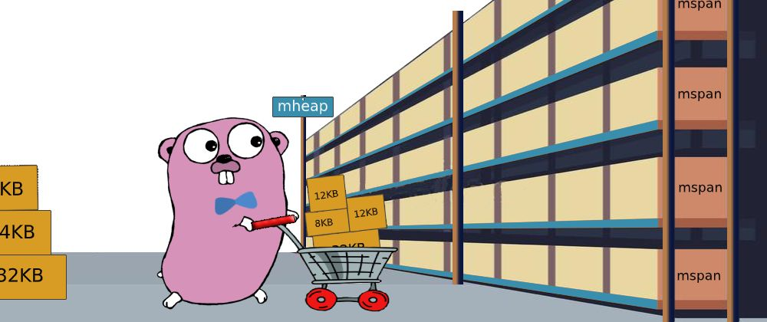

COP290 LAB-3 PRESENTATION
SYSMALLOC

Slide 2
Inspired by Stackoverflow
Question and answer forum for users to discuss and help resolve queries in ANY LANGUAGE, which can be finally viewed in English.
Various functionalities explained further

Slide 3

HOMEPAGE
SIGN UP
LOG IN

Slide 4

TOP QUESTIONS PAGE
SIDEBAR:
- QUESTIONS
- USERS
ASK QUESTION
NEWEST, SCORE, UNANSWERED (sorting)
SEARCH BAR
LOGOUT
PARTICULAR QUESTION ON CLICKING IT

Slide 5

QUESTIONS-> ALL QUESTIONS PAGE
SIDEBAR:
- QUESTIONS
- USERS
ASK QUESTION
NEWEST, SCORE, UNANSWERED (sorting)
SEARCH BAR
LOGOUT
PARTICULAR QUESTION ON CLICKING IT

Slide 6

USERS-> ALL USERS PAGE
SEARCH BY USER
PARTICULAR USER’S PROFILE ON CLICKING
LOGOUT

Slide 7


USER’S PROFILE PAGE
FOLLOWERS
FOLLOWING
FEED
EDIT PROFILE
Stats
Questions asked
LOGOUT

Slide 8

PARTICULAR QUESTION PAGE
Detailed Question
OPTION TO TRANSLATE QUESTION IN DIFFERENT LANGUAGE TO ENGLISH
(GOOGLE TRANSLATE ML API)
OPTION TO POST ANSWER
EXISTING ANSWERS
LOGOUT

